Slide 1



Just IT Bootcamp : Data Analysis
Raziah Quallatein Mwawanga

Slide 2


Objectives
Analyse Cinemax Rentals' data using Data extracted from MySQL and Powerbi to visualise.
Analyse the data using descriptive, diagnostic and predictive data analysis.

Slide 3
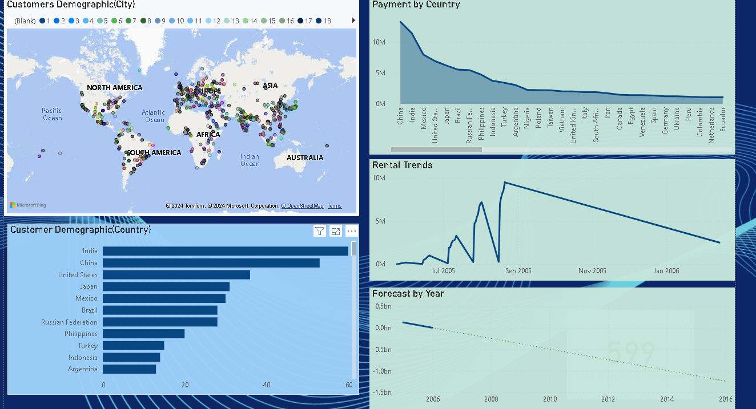

Slide 4

Customer Demographics (City)
Customers' demographics by the city show that Asian European cities have the most customers renting from CineMax Rentals.
The South and North American cities also have more customers but fewer than the European and Asian cities.
The African cities have fewer customers in cities renting from CineMax compared to Australian cities with no customers.

Slide 5
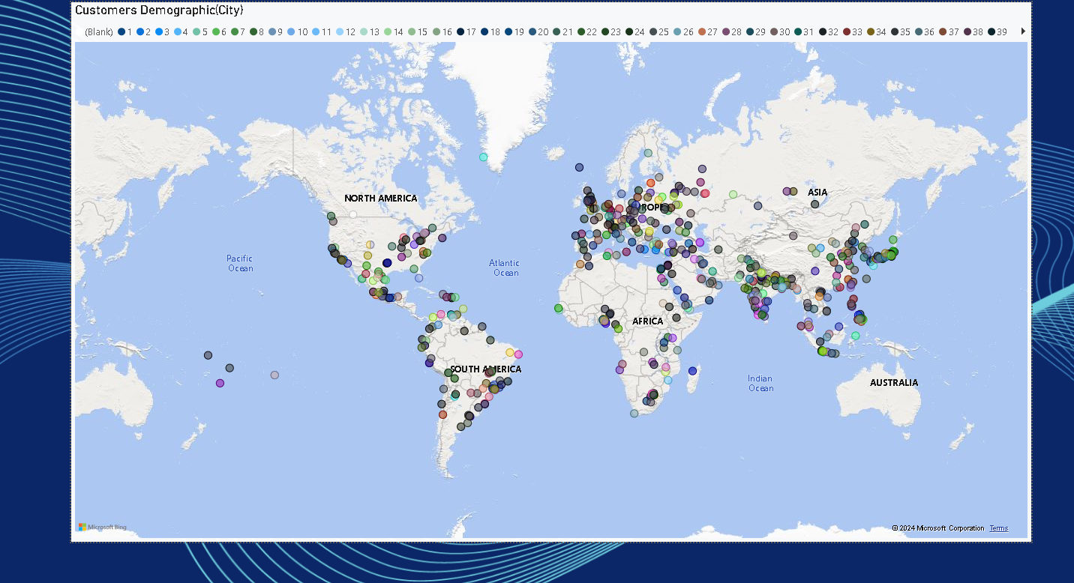

Slide 6
Customer Demographics ( Country)
Customers' demographics by country show that India has the highest number of customers, followed by China, the United States, Japan, Mexico, Brazil, and the Russian Federation, respectively.
There are no Customers in Australia renting from CineMax Rentals.
The countries with more customers could be a result of the population of the countries.

Slide 7
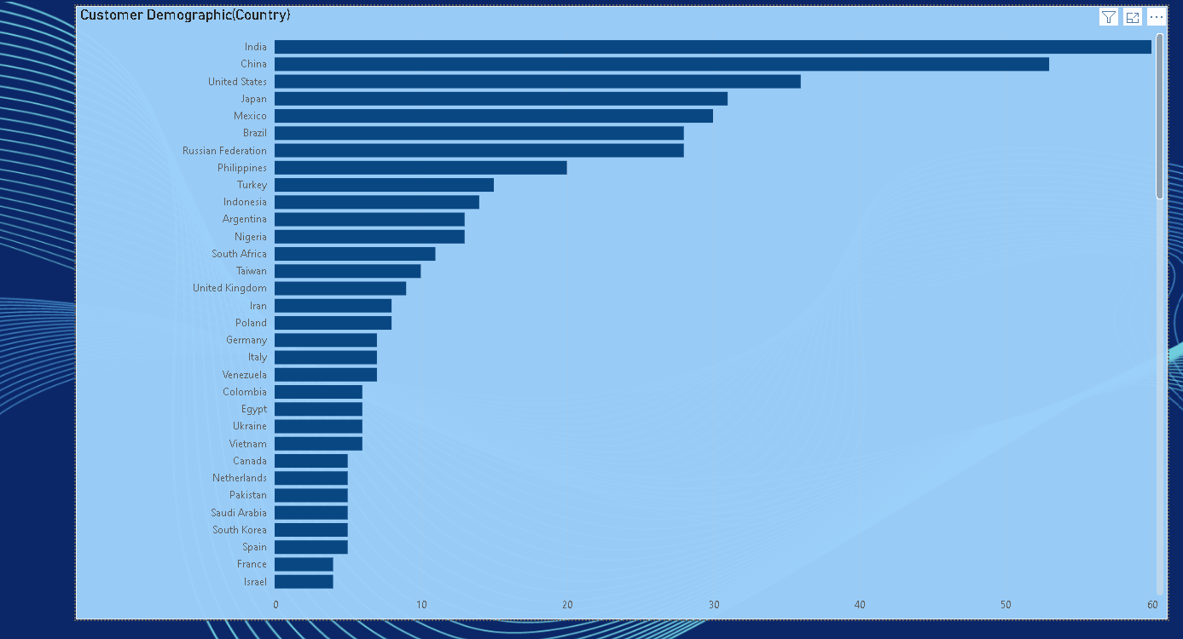

Slide 8
Rental Trends
The past two years of CineMax Rentals renting have shown an unstable situation. August 2005 had the highest rentals, while May 2005 had the lowest.
New film releases could explain this trend between May 2005 and August 2006.When a new film is released, many customers rush to rent it.
Another possible reason for the decline from September 2005 could be technological advancement. As online streaming services such as Netflix, Sky, DSTV, and YouTube emerge, many people will probably stop renting and move on to the new technology.

Slide 9
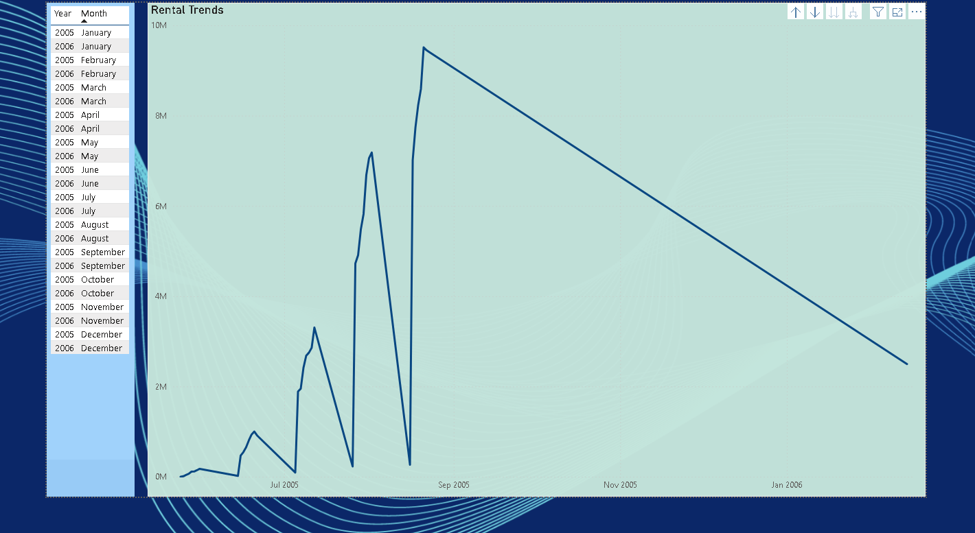

Slide 10
Payment Analysis
The payment visual shows that China, with 53 customers, contributed more to the revenue, followed by India, with 60 customers, the second-most contributor to the payment revenue. It does show that the number of customers is independent of an increase in revenue. Australia had no customers and did not contribute to the revenue. Zambia had 1 customer, which contributed to the revenue.

Slide 11
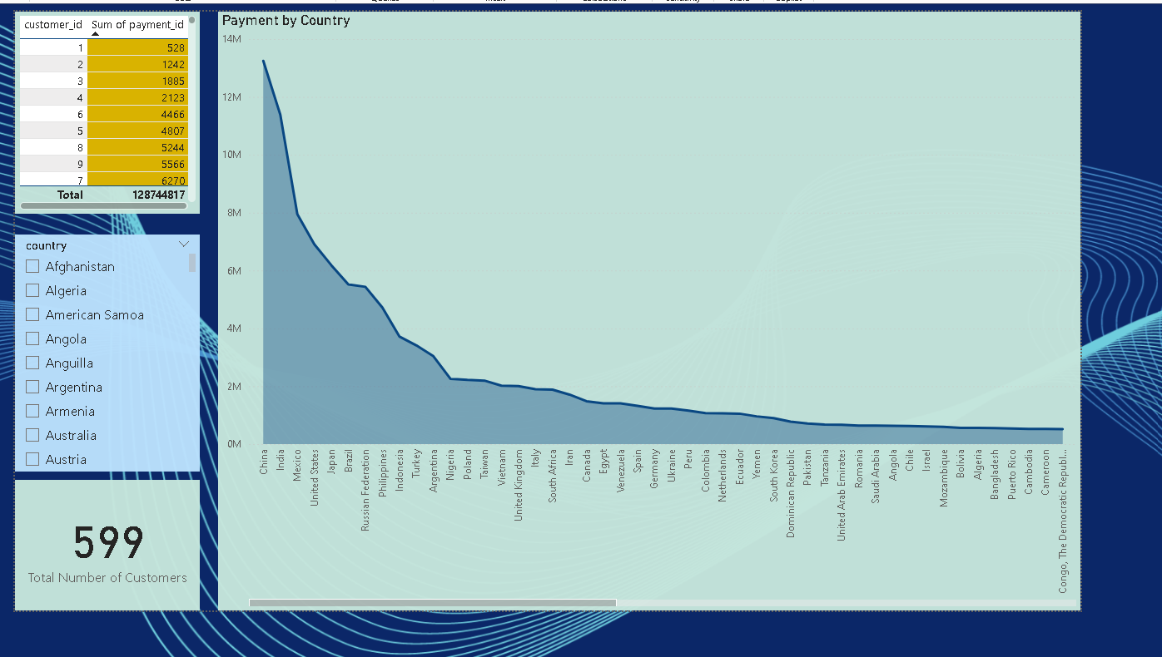
£
£

Slide 12
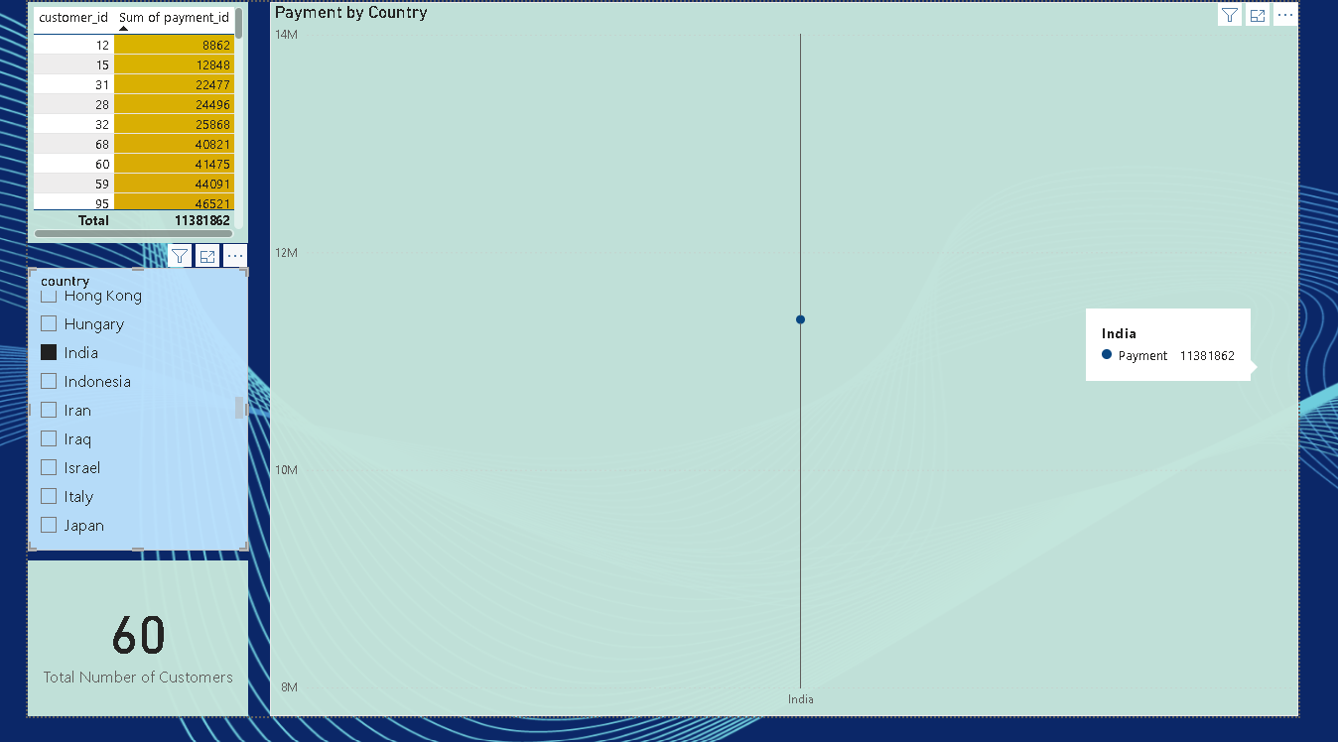
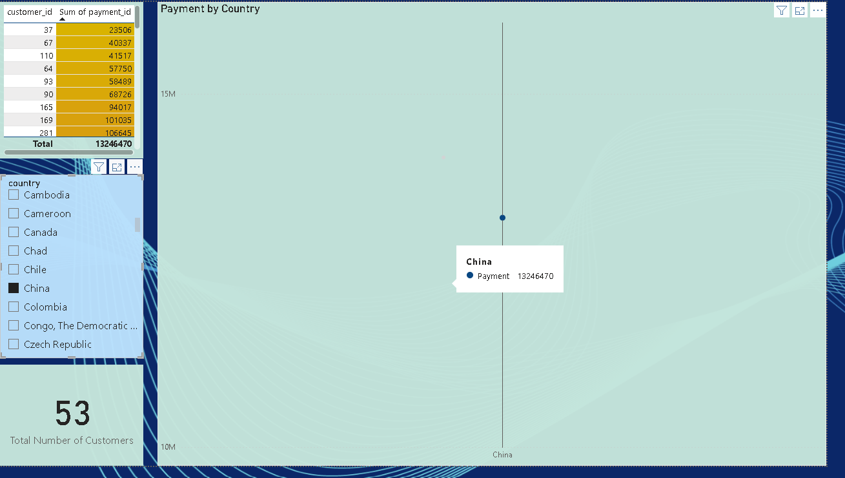

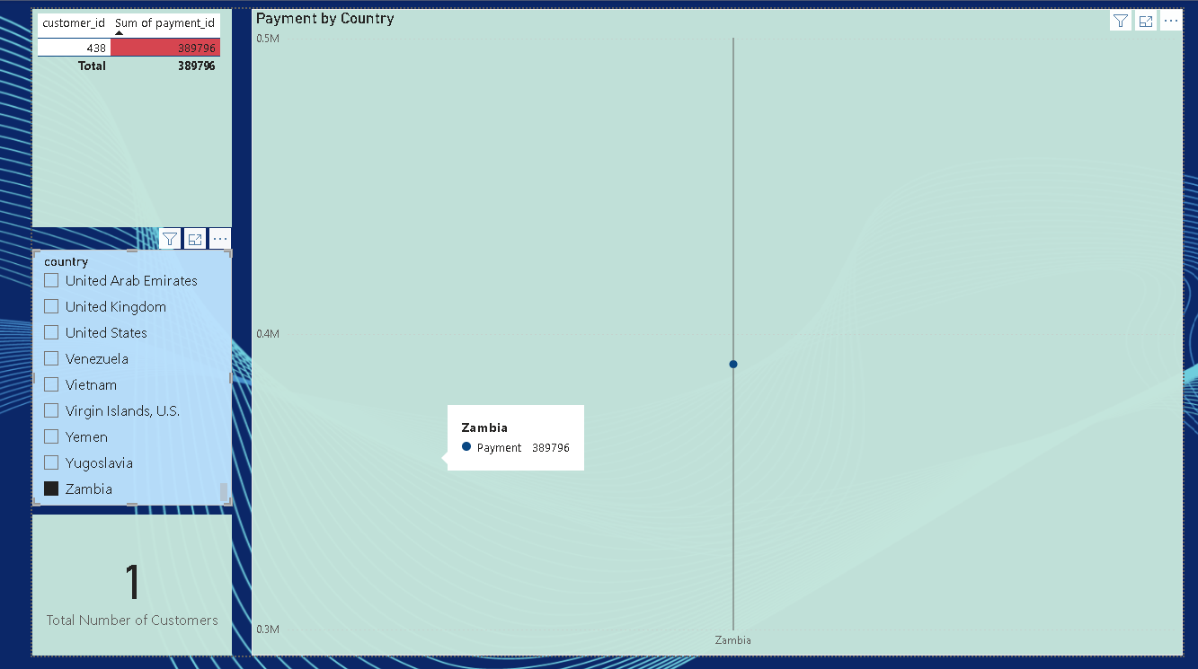
£
£
£

Slide 13
Payment Analysis
Tanzania, the United Kingdom, the United States, and Nigeria contributed to the revenue, with each country having 3,9,36 and 13 customers, respectively.

Slide 14
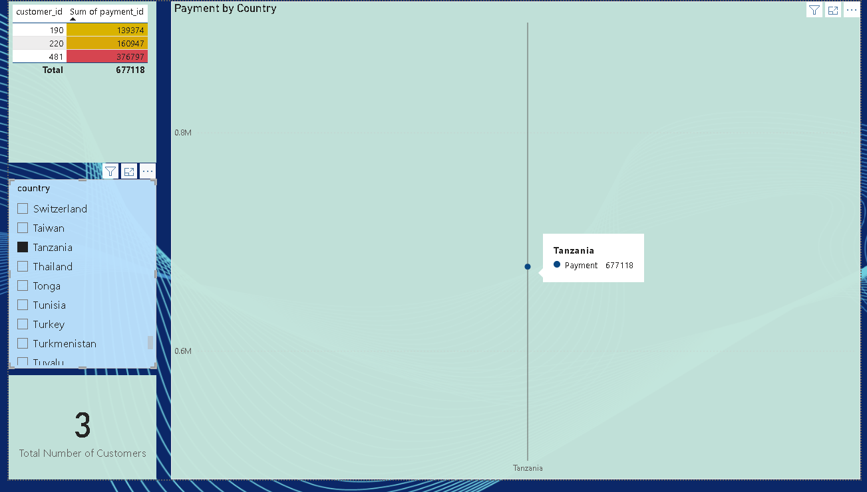
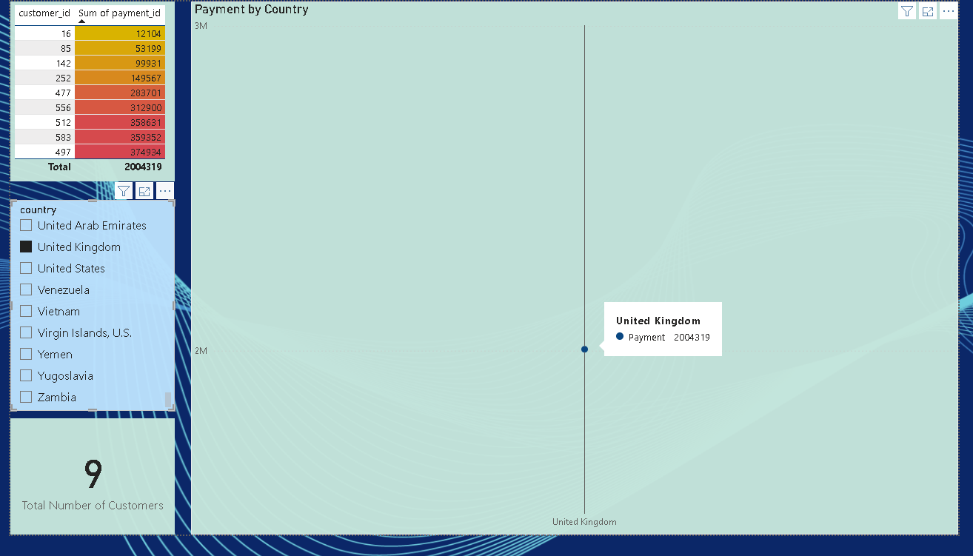
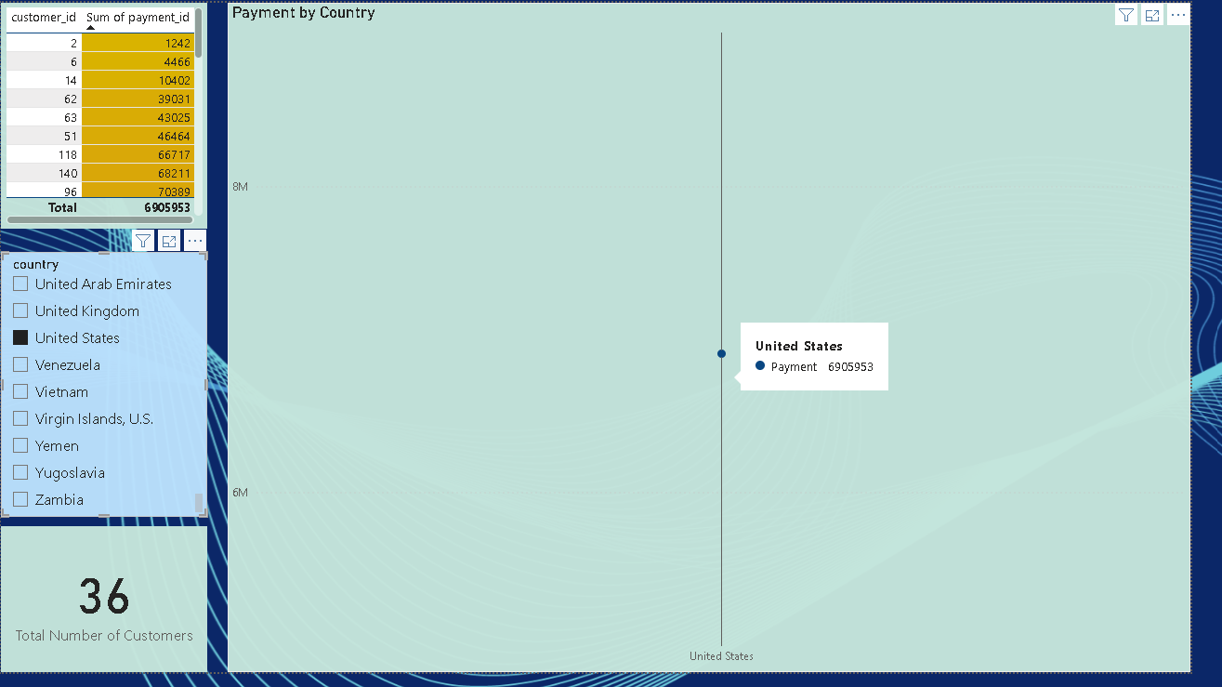
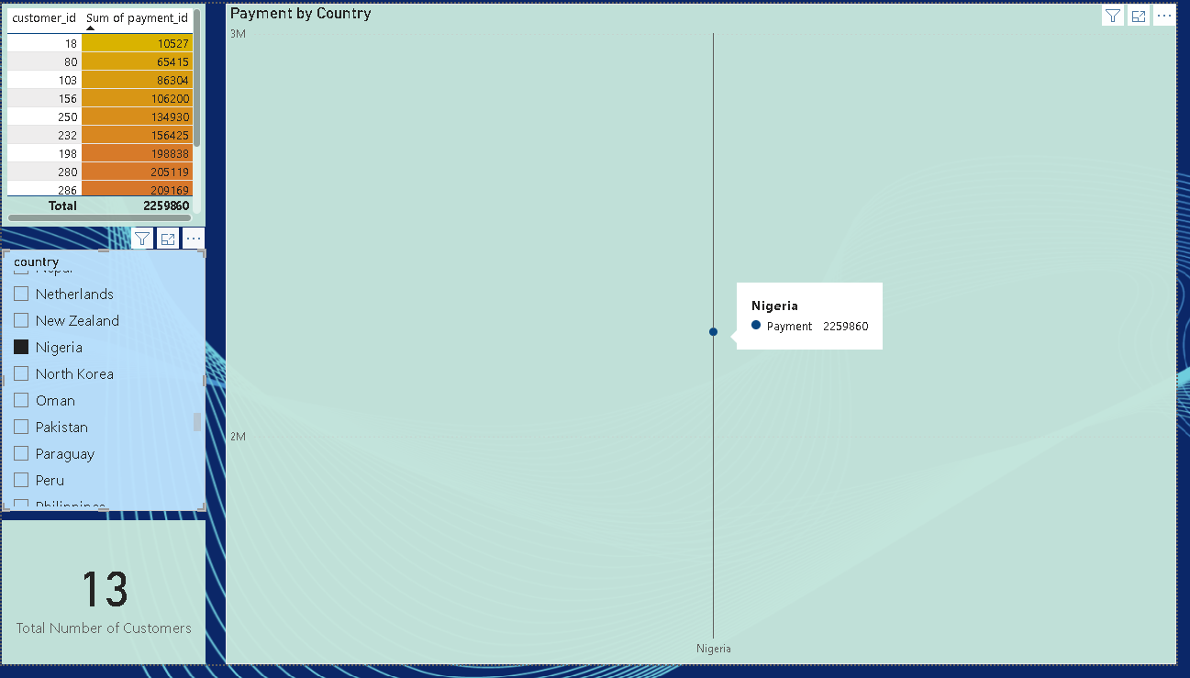
£
£
£
£

Slide 15
Revenue Forecast
Based on the rental revenue for the past two years, the visuals show that there will be a decline in the next quarter's revenue. The rental trends will continue to decline, and CineMax will no longer have customers.

Slide 16
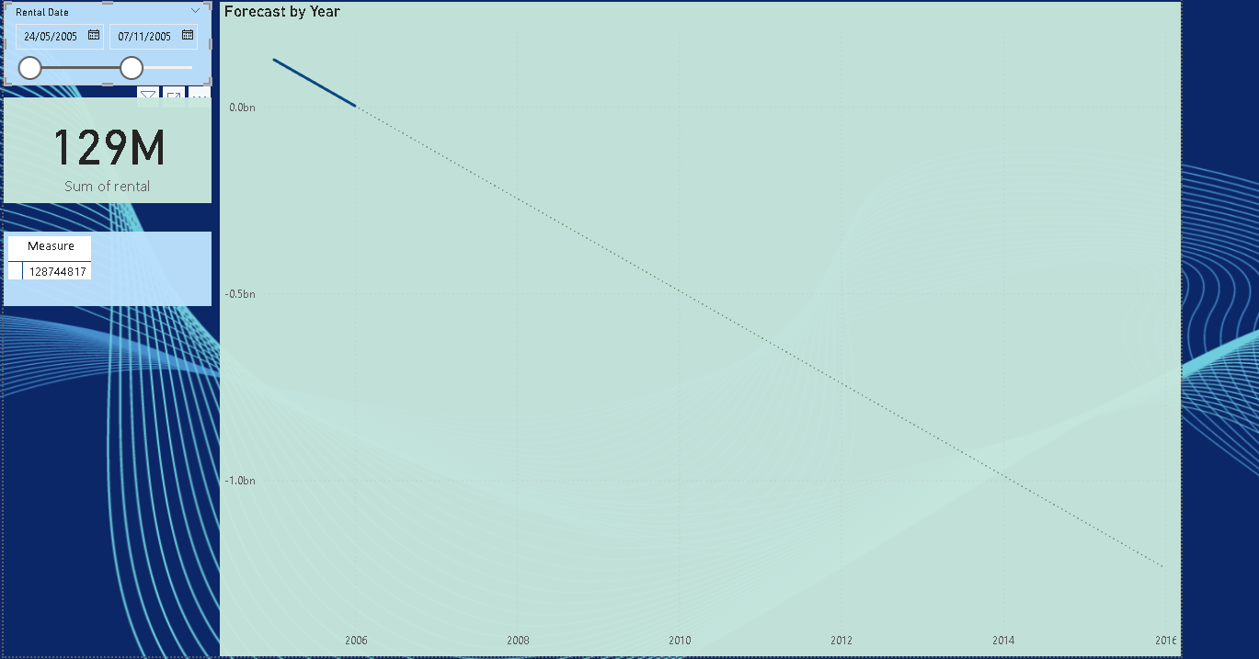
£

Slide 17
CineMax Rentals Data Analysis
Descriptive Analysis shows that Asian and European cities have the most customers based on their high population and income, led by India, China, the United States, Japan, Mexico, Brazil, and the Russian Federation, respectively. South and Northern America follow this, compared to the African Continent, which has fewer customers and none in Australia.
Diagnostic Analysis shows decreasing and unstable business growth in the past two years, with August 2005 having the highest rentals and May 2005 having the lowest based on new film releases and customers' renting patterns. Another reason for the decline in business since September 2005 could be new technological innovations and advancements, such as customers opting for online streaming services such as Netflix, Sky, DSTV, and YouTube instead of renting.
Predictive Analysis shows a rental revenue decline for the past two years and a subsequent decline in the next quarter's revenue. Rental trends will continue to decline, and CineMax will no longer have customers. The business will no longer be profitable and will probably go bankrupt.

Slide 19
Recommendations
Data analysis for CineMax Rentals indicates a decline in revenue due to technological advancements. Customers are moving to online streaming and subscriptions rather than renting films. It is dangerous for the business because film rentals are the only profit source. It needs to think of innovative alternative revenue sources and new business models to remain relevant, move with technology advancement, retain customers and attract new customers through creating its own paid online subscription streaming model and transform old films to maintain two revenue streams to keep old customers and attract new customers.
Another recommendation is that Cinemax diversify into other businesses because rental and customer numbers will decline in subsequent quarters and years, leading to loss and the company's possible collapse.

Slide 21
Film Inventory
The current inventory status shows 4.581k for both stores, with 1000 for each film title in each store.

Slide 22
